Slide 1
Reflect & Connect
Journal your thoughts and be directed to neighborhood happenings.
Daniel Blackburn
Marchex Analyst/Developer
Catherine Grabar
Microsoft/Bing
UX Designer
Janice Tufte
Hassana Consulting
Patient Engaged in Research
Delores Maria Rossman
Gerontologist/Consultant Rossman-Guerrero y Asociados
Carli Hoki
Universal Interior Design

Slide 2
Concern
Goals
Social isolation of older adults in densely populated urban environment.
Provide an outlet for inner reflection and the opportunity to better one’s quality of life.
Address the need for socially isolated individuals to connect easily with neighbors and new acquaintances to feel connected to society.
Create a simple solution which reaches a demographic that most technology-focused solutions do not reach. Our design for older adults is inherently universal, and can be expanded to other populations or languages.

Slide 3
How it Works
Natural Language
Processing
Seattle Events and Activities displayed
Social Interaction with like minded groups
Private
Journal Entries
Reflect and Connect is an opportunity for inner reflection and meditation by logging how you’re feeling. Your thoughts will be kept private while word recognition software identifies key phrases and pulls happenings in your immediate community you may be interested in. Connect with groups who have common interests. Embark on the journey of self-improvement towards better quality life and health.

Slide 4

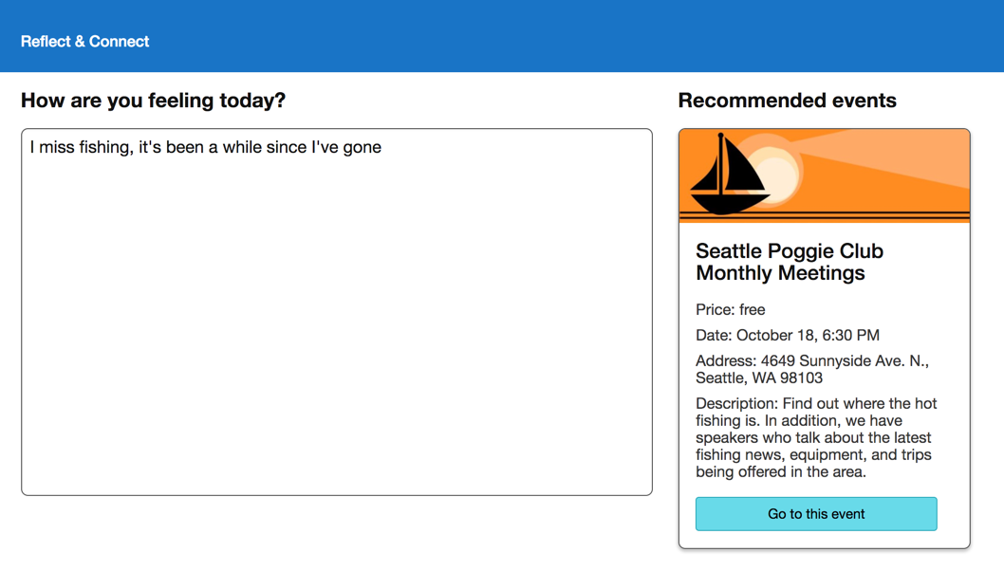
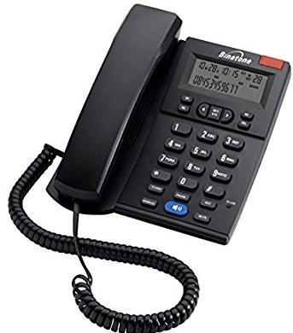




Reflect & Connect
The full-featured solution accessible by web or standard telephone to overcome technology obstacles for the older adult population.
Journal Entries are made by typing or speech.
Get me there

Slide 5
Demonstration
Reflect & Connect
Journal your thoughts and be directed to neighborhood happenings.

